Slide 1


Slide 2


Android Development

Slide 3

Course objectives
Android Development
By completing this course you will be able to:
  Add menu in your application
  Interating with user

Slide 4


Course plan
Android Development
  Menus
  Intents
  Fragments
  Dialogs
  Toasts

Slide 5
Menus
Android Development

Slide 6

Menus
Android Menu
Android provides two types of menus
  The Options menu
    Displayed when the Menu button is pressed
  Context menus
    Displayed when a long press is performed on a view
    Similar to a right-click menu in Windows
Menus are defined as XML resources
Notes:
[Title of the course]
Nov 8, 2008
Copyright © 2004-2005 NameOfTheOrganization. All rights reserved.
6
http://developer.android.com/design/style/iconography.html

Slide 7
Menus
Defining Menu
Menus are defined as XML files in res/menu
  The name of the XML file is its resource identifier
Each item in the menu is defined by an <item> element
  Attributes include
    id: declares a resource identity for the menu item
    title: a resource identifier for the text to display
    icon: a resource identifier for an icon to show
<menu xmlns:android="http://schemas.android.com/apk/res/android">
<item android:id="@+id/menu_sync"
android:title="@string/menu_str_sync"
android:icon="@drawable/ic_menu_sync" />
</menu>
Notes:
[Title of the course]
Nov 8, 2008
Copyright © 2004-2005 NameOfTheOrganization. All rights reserved.
7

Slide 8
Menus
Inflating Menu
Menus are loaded from XML resources using a MenuInflater
  Inflation creates a Java object from the XML resource
Inflation is performed in one of two event handler methods in Activity
  Called when it is time to display the menu
The Android framework always calls onCreateOptionsMenu()
onCreateContextMenu() is only called if registerForContextMenu(View view) has previously been called
registerForContextMenu() must be called for each View for which a Context menu is required
public boolean onCreateOptionsMenu(Menu menu)
public void onCreateContextMenu(ContextMenu menu, View v, ContextMenuInfo menuInfo)
Notes:
[Title of the course]
Nov 8, 2008
Copyright © 2004-2005 NameOfTheOrganization. All rights reserved.
8

Slide 9
Menus
Inflating Menu
Inflation is the same for both the Options and Context menus
@Override
public boolean onCreateOptionsMenu(Menu menu) {
// Create an instance of the Menu inflater
MenuInflater inflater = getMenuInflater();
// Inflate the menu
inflater.inflate(R.menu.menu, menu);
// Return true if the menu inflated OK
return true;
}
Notes:
[Title of the course]
Nov 8, 2008
Copyright © 2004-2005 NameOfTheOrganization. All rights reserved.
9

Slide 10
Menus
Handling Menu
Handling Options menu events
  MenuItem parameter used to identify the selected menu item
Context menus
public boolean onOptionsItemSelected(MenuItem item){
// Get the Id of the selected menu item
switch (item.getItemId()) {
case R.id.menu_refresh:
return true;
case R.id.menu_add:
return true;
default:
return super.onOptionsItemSelected(item);
}
}
public boolean onContextItemSelected(MenuItem item)
Notes:
[Title of the course]
Nov 8, 2008
Copyright © 2004-2005 NameOfTheOrganization. All rights reserved.
10

Slide 11
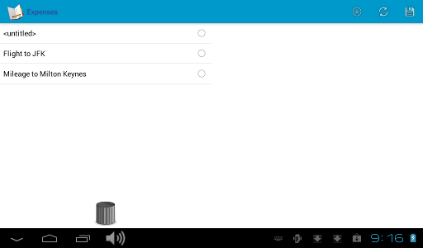
Menus
Action Bar Menu
The Action Bar displays options menu items at
the top of the screen
Options menu items may be displayed as actions
  Add an icon to the menu item
  Set the showAsAction attribute
<menu …>
<item …
android:icon="@drawable/ic_menu_add"
android:showAsAction="ifRoom|withText" />
Notes:
[Title of the course]
Nov 8, 2008
Copyright © 2004-2005 NameOfTheOrganization. All rights reserved.
11

Slide 12
Menus
Action Bar Menu
Action bar is configured in the manifest
  Automatically enabled if targetSdkVersion is >= 11
  May be disabled by setting the theme to a
  non-holographic theme
<uses-sdk android:targetSdkVersion="11"…
<activity android:theme="@android:style/Theme.Holo.Light" …
Notes:
[Title of the course]
Nov 8, 2008
Copyright © 2004-2005 NameOfTheOrganization. All rights reserved.
12

Slide 13
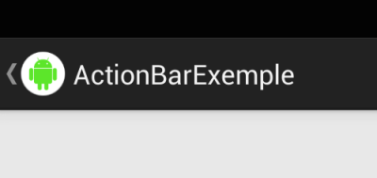
Menus
Action Bar Menu Navigation
To go Back with the Application Icon :
  Load Action bar menu with XML
  Activate “DisplayHomeAsUpEnable in onCreate function
  complete the code in onOptionsItemSelected
ActionBar actionBar = getActionBar();
actionBar.setDisplayHomeAsUpEnabled(true);
int id = item.getItemId();
if(id == android.R.id.home) {
onBackPressed();
}
Notes:
[Title of the course]
Nov 8, 2008
Copyright © 2004-2005 NameOfTheOrganization. All rights reserved.
13

Slide 14
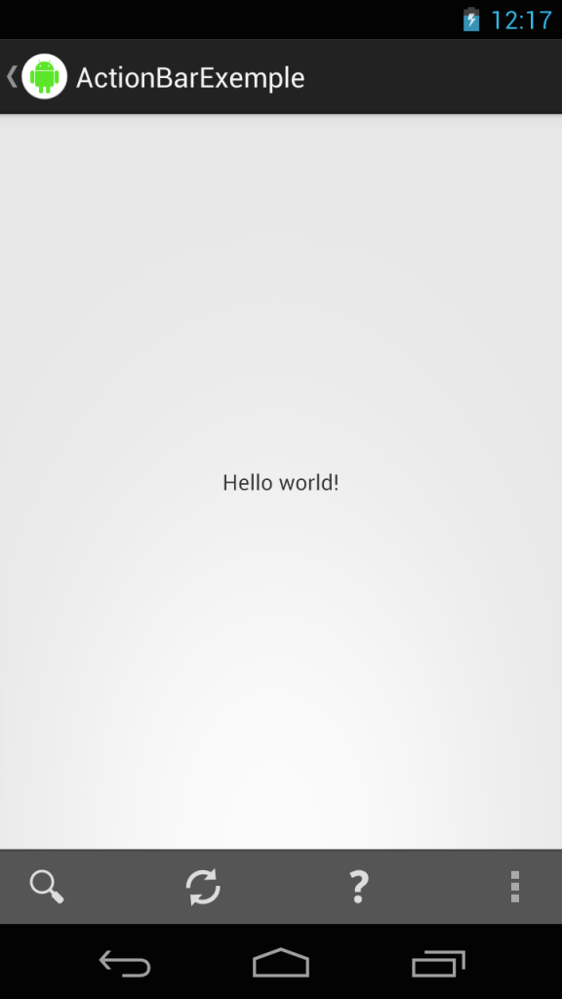
Menus
Action Bar split
To split actionBar in Top and Bottom
  Add uiOptions attribute in manifest with value : splitActionBarWhenNarrow
<activity
android:name=".views.detail.DetailActivity"
android:label="@string/title_activity_detail"
android:uiOptions="splitActionBarWhenNarrow">
</activity>
Notes:
[Title of the course]
Nov 8, 2008
Copyright © 2004-2005 NameOfTheOrganization. All rights reserved.
14

Slide 15
Questions ?

Slide 16
Intents
Android Development

Slide 17

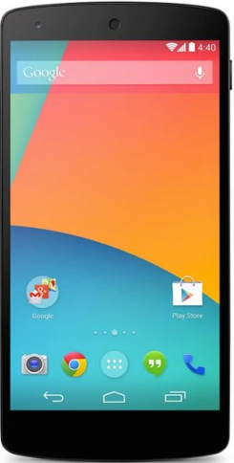
Intents
Presentation
An intent is an abstract description of an operation to be performed
We can use it to :
  Launch an Activity
  Communicate with components like :
    Background Services
    Broadcast Receivers
The first one is the most common usage
  We’ll only see it
Notes:
[Title of the course]
Nov 8, 2008
Copyright © 2004-2005 NameOfTheOrganization. All rights reserved.
17

Slide 18

Intents
Launch an Activity
To simply launch an activity :
One of Instant constructors take only this two parameters :
  The context of the intent, here the activity instance creating it
  The component class used for the intent
startActivity(Intent) :
  An instance method of Activity class to start a new activity with an intent
Intent intent = new Intent(this, ActivityToLaunch.class);
startActivity(intent);
Notes:
[Title of the course]
Nov 8, 2008
Copyright © 2004-2005 NameOfTheOrganization. All rights reserved.
18

Slide 19

Intents
Note
Remember :
An Activity have to be declared inside Android Manifest file to be launched.
Notes:
[Title of the course]
Nov 8, 2008
Copyright © 2004-2005 NameOfTheOrganization. All rights reserved.
19

Slide 20
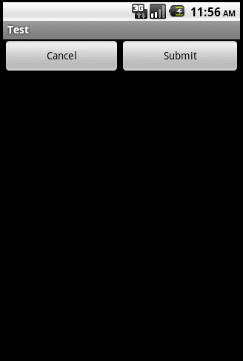
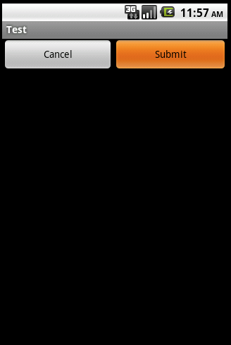
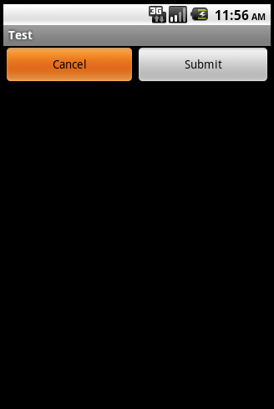
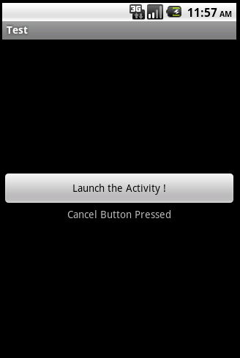
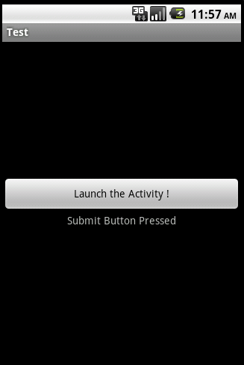
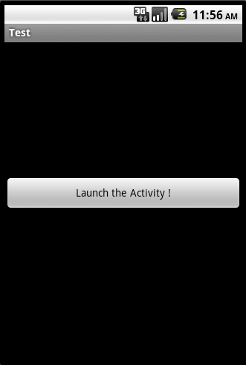
Intents
Launch an Activity
You can also start an Activity and wait a result code from it :
Notes:
[Title of the course]
Nov 8, 2008
Copyright © 2004-2005 NameOfTheOrganization. All rights reserved.
20

Slide 21
Intents
Launch an Activity
To do that, just use the method startActivityForResult(…) instead of startActivity(…) :
...
private static final int MY_ACTIVITY_CODE = 1;
...
Intent intent = new Intent(this, ActivityToLaunch.class);
// MY_ACTIVITY_CODE Constant represent an id for the
// request that will be used later identify the activity
// returning the result.
startActivityForResult(intent, MY_ACTIVITY_CODE);
Notes:
[Title of the course]
Nov 8, 2008
Copyright © 2004-2005 NameOfTheOrganization. All rights reserved.
21

Slide 22
Intents
Launch an Activity
In the launched activity, use the setResult(…) method to return a result code to the launching activity :
Button submitButton = (Button) findViewById(R.id.submit);
submitButton.setOnClickListener(new View.OnClickListener() {
public void onClick(View view) {
setResult(RESULT_OK);
finish();
}
});
Notes:
[Title of the course]
Nov 8, 2008
Copyright © 2004-2005 NameOfTheOrganization. All rights reserved.
22

Slide 23
Intents
Launch an Activity
In the launching activity, override the onActivityResult(…) method :
protected void onActivityResult(int requestCode,
int resultCode, Intent data) {
switch (requestCode) {
case MY_ACTIVITY_CODE:
TextView textView = …
switch (resultCode) {
case RESULT_CANCELED :
textView.setText("Cancel Button Pressed");
break;
case RESULT_OK :
textView.setText("Submit Button Pressed");
break;
}
...
}
}
Notes:
[Title of the course]
Nov 8, 2008
Copyright © 2004-2005 NameOfTheOrganization. All rights reserved.
23

Slide 24
Intents
Include Extra Data
When you launch another activity, you often need to communicate some information
You can use the intent methods below :
  void putExtra(…)
  Bundle getExtras(…)
Supported types are :
  Primitives : byte, short, int, long, float, double, …
  Primitive Arrays : int[], long[], …
  Strings
  Serializable objects
Notes:
[Title of the course]
Nov 8, 2008
Copyright © 2004-2005 NameOfTheOrganization. All rights reserved.
24

Slide 25
Intents
Include Extra Data
To put an extra data :
To retrieve it in the launched Activity :
Intent getIntent() :
  Return the intent that started this activity
Intent intent = new Intent(this, MyActivity.class);
intent.putExtra("smthg", "Hi Activity.");
startActivity(intent, MY_ACTIVITY_CODE);
Bundle extras = getIntent().getExtras();
if(extras != null) {
String message = extras.getString("smthg");
}
Notes:
[Title of the course]
Nov 8, 2008
Copyright © 2004-2005 NameOfTheOrganization. All rights reserved.
25

Slide 26

Intents
Include Extra Data
If an Activity has been launched by startActivityForResult(…) method :
  It can send information to the launching Activity
    In sending an intent in addition to result code
You can retrieve it in the launching Activity in the onActivityResult(…) method
Notes:
[Title of the course]
Nov 8, 2008
Copyright © 2004-2005 NameOfTheOrganization. All rights reserved.
26

Slide 27
Intents
Include Extra Data
  Launched Activity :
  Launching Activity :
...
myIntent
.putExtra(“message”, “Thank you for calling me”);
setResult(RESULT_OK, myIntent);
finish();
...
protected void onActivityResult(int requestCode,
int resultCode, Intent data) {
…
Bundle extras = data.getExtras();
if(extras != null) {
String message = extras.getString(”message");
}
}
Notes:
[Title of the course]
Nov 8, 2008
Copyright © 2004-2005 NameOfTheOrganization. All rights reserved.
27

Slide 28
Intents
Implicit Intents
Two primary forms of intents :
  Explicit Intents :
    Provide the exact class to be run
  Implicit Intents :
    Component to run determined by the system
We just saw the first one
We’re going to see the second one
Notes:
[Title of the course]
Nov 8, 2008
Copyright © 2004-2005 NameOfTheOrganization. All rights reserved.
28

Slide 29
Intents
Implicit Intents
Implicit Intents are based on Actions
Android provide many native Actions
  But you can create your own.
You have mainly two constructors to create an implicit Intent :
  Intent (String action)
  Intent (String action, Uri uri)
Notes:
[Title of the course]
Nov 8, 2008
Copyright © 2004-2005 NameOfTheOrganization. All rights reserved.
29

Slide 30
Intents
Native Actions
Action | Definition
ACTION_ANSWER | Handle an incoming phone call.
ACTION_CALL | Perform a call to someone specified by the data.
ACTION_DELETE | Start an Activity to delete the given data from its container.
ACTION_DIAL | Shows an UI with the number being dialed, allowing the user to explicitly initiate the call.
ACTION_EDIT | Provide explicit editable access to the given data.
ACTION_SEARCH | Perform a search.
ACTION_SEND | Deliver some data to someone else by SMS or e-mail.
ACTION_SENDTO | Send a message to someone specified by the data.
ACTION_VIEW | Starting the default activity associated with the data to view it.
ACTION_WEB_SEARCH | Perform a web search.
Notes:
[Title of the course]
Nov 8, 2008
Copyright © 2004-2005 NameOfTheOrganization. All rights reserved.
30

Slide 31
Intents
Native Actions
Example :
  Launch the Google Play:
  Launch a Web browser :
Uri uri = Uri.parse(“market://search?”
+ “q=pname:com.google.android.stardroid”);
Intent intent = new Intent(Intent.ACTION_VIEW, uri);
startActivity(intent);
Uri uri = Uri.parse(“https://www.hesias.fr”);
Intent intent = new Intent(Intent.ACTION_VIEW, uri);
startActivity(intent);
Notes:
[Title of the course]
Nov 8, 2008
Copyright © 2004-2005 NameOfTheOrganization. All rights reserved.
31

Slide 32
Intents
Native Actions
Example :
  Call a number :
    To make this piece of code work
      You have to specify that the application have the permission to call.
      Just add a <use-permission> element in your Android Manifest.
Uri uri = Uri.parse(“tel:0607080910”);
Intent intent = new Intent(Intent.ACTION_CALL, uri);
startActivity(intent);
<uses-permission
android:name="android.permission.CALL_PHONE” />
Notes:
[Title of the course]
Nov 8, 2008
Copyright © 2004-2005 NameOfTheOrganization. All rights reserved.
32

Slide 33
Questions ?

Slide 34
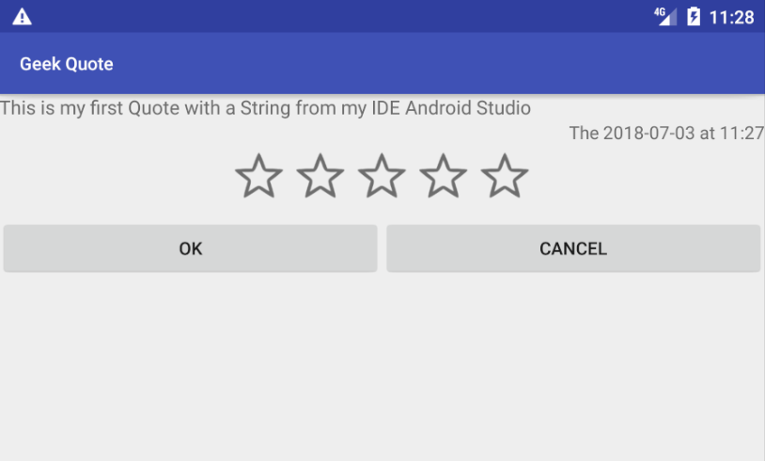
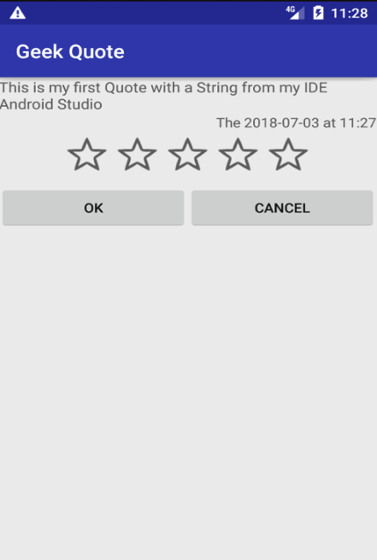
Intents
Exercise (1/2)
Now, you know how to use Intents :
  Create a new Activity named QuoteActivity :
    User Interface should be something like that :
Notes:
[Title of the course]
Nov 8, 2008
Copyright © 2004-2005 NameOfTheOrganization. All rights reserved.
34

Slide 35
Intents
Exercise (2/2)
This activity have to be launch when an user click on a element of the ListView
It have to display :
  A TextView with the text of the selected quote
  Another TextView with the date of the selected quote
  A RatingBar with the rating of the selected quote
    This element is editable to allow user to change the rating
  A Cancel button which return to the previous Activity without save the new ratting
  A Ok button which return to the previous Activity with the new ratting value
Notes:
[Title of the course]
Nov 8, 2008
Copyright © 2004-2005 NameOfTheOrganization. All rights reserved.
35

Slide 36
FRAGMENTS
Android Development

Slide 37
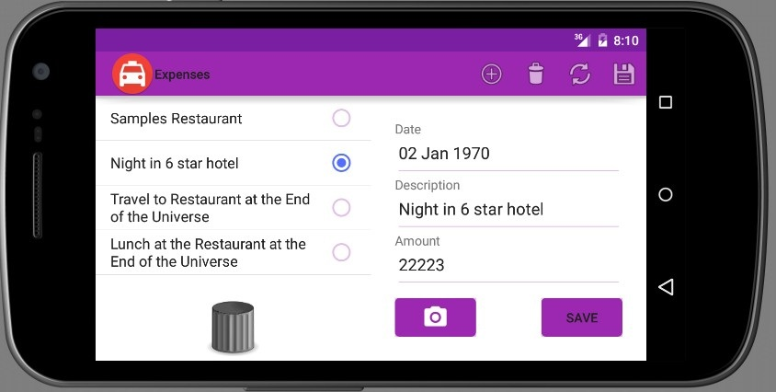
Fragments
Interface Fragment
Multi-pane user interfaces
  Takes advantage of larger screens
  Each pane is a fragment
A single activity may host multiple fragments
  For example, a list of expenses and an expense editing fragment
Allows fine-grained control over window content
Notes:
[Title of the course]
Nov 8, 2008
Copyright © 2004-2005 NameOfTheOrganization. All rights reserved.
37

Slide 38
Fragments
Activities & Fragments
View
View
Fragments are very similar to activities
  With some additional life cycle methods
  They still have a View
Fragment offers greater flexibility than Activity
  Multiple fragments may be active
  Can optionally be placed in the back stack
Fragments are loaded into the View of an
Activity
  Either statically through resource definitions
  Or dynamically through the FragmentManager
Fragment
Fragment
ViewGroup
Activity
Notes:
[Title of the course]
Nov 8, 2008
Copyright © 2004-2005 NameOfTheOrganization. All rights reserved.
38

Slide 39
Fragments
Interface Fragment
Start
onAttach()
Fragment life cycle adds five
new methods to the activity life cycle
onCreate()
onCreateView()
Life cycle method | Description
onAttach | The Fragment has been associated with an Activity
onCreateView | The Fragment must create its View
onActivityCreated | The parent Activity has completed its creation
onDestroyView | The View associated with the Fragment is being destroyed
onDetach | The Fragment is about to be disassociated from the Activity
onActivityCreated()
onStart(), onResume()
onPause(), onStop()
onDestroyView()
onDestroy()
onDetach()
Shutdown
Notes:
[Title of the course]
Nov 8, 2008
Copyright © 2004-2005 NameOfTheOrganization. All rights reserved.
39

Slide 40
Fragments
Implementing Fragment
The core life cycle functions for fragments are identical to those of activities
  If migrating Activity to Fragment, start with the existing life cycle code
    onCreate(), onPause(), onResume()…
Notes:
[Title of the course]
Nov 8, 2008
Copyright © 2004-2005 NameOfTheOrganization. All rights reserved.
40

Slide 41
Fragments
Implementing Fragment
Two significant extra methods on Fragment
  onCreateView()
    Used to associate a View with the Activity
    The fragment must create its view here
  onActivityCreated()
    Indicates that the parent Activity has completed its onCreate()
    A good location to initialize data, such as list queries
View onCreateView(LayoutInflater inflater,
ViewGroup container, Bundle savedInstance)
void onActivityCreated (Bundle )
Notes:
[Title of the course]
Nov 8, 2008
Copyright © 2004-2005 NameOfTheOrganization. All rights reserved.
41

Slide 42
Fragments
Inflating a View for Fragment
A fragment must inflate its own view
  Unlike an activity, which just calls setContentView(R.layout.main);
In the onCreateView() method
  Use inflater.inflate, passing the resource ID of the layout
@Override
public View onCreateView(LayoutInflater inflater, ViewGroup container, Bundle savedInstanceState) {
return inflater.inflate(R.layout.expenses_form, container, false);
}
Notes:
[Title of the course]
Nov 8, 2008
Copyright © 2004-2005 NameOfTheOrganization. All rights reserved.
42

Slide 43
Fragments
Communicating with Activity
Fragment code will need to access its parent Activity
  May need to interact with the parent
  May need to use methods from Context
Fragments are not subclasses of either Activity or Context
  But can easily access the parent Activity through getActivity()
When migrating activities to fragments, one of the major tasks is to convert all of the context references to use getActivity()!
Activity parentActivity = getActivity();
Notes:
[Title of the course]
Nov 8, 2008
Copyright © 2004-2005 NameOfTheOrganization. All rights reserved.
43

Slide 44
Fragments
Declaring & Loading From Ressources
The simplest way of loading a fragment
  Declare it in the layout of the Activity
  Loading takes place automatically
  class attribute identifies the fragment class
<LinearLayout
android:orientation="horizontal" …>
<fragment
class="com.ltree.expenses.ExpensesListFragment"
android:id="@+id/frag_expense_list"
android:layout_width=…
/>
...
Notes:
[Title of the course]
Nov 8, 2008
Copyright © 2004-2005 NameOfTheOrganization. All rights reserved.
44

Slide 45
Fragments
Fragment Transactions
Fragments can be loaded dynamically using the FragmentManager
  Create a Fragment
  Create a FragmentTransaction
    Ensures all transactions occur in a single action
  Use the replace() method to add the Fragment to the transaction
    Specify the ID of a ViewGroup to hold the Fragment
  Specify the transition animation
  Commit the transaction
Notes:
[Title of the course]
Nov 8, 2008
Copyright © 2004-2005 NameOfTheOrganization. All rights reserved.
45

Slide 46
Fragments
Fragment Transactions
ExpenseEntryFragment frag = new ExpenseEntryFragment();
// Execute a transaction, replacing any existing fragment
FragmentTransaction ft = getFragmentManager().beginTransaction();
// Set transaction to replace (or add)
ft.replace(R.id.frag_expense_details, frag);
// Specfiy an effect for the transition
ft.setTransition(FragmentTransaction.TRANSIT_FRAGMENT_FADE);
// Commit
ft.commit();
Notes:
[Title of the course]
Nov 8, 2008
Copyright © 2004-2005 NameOfTheOrganization. All rights reserved.
46

Slide 47
Fragments
Fragment and the Back Stack
When fragments are associated with a view
  The fragment transaction may be added to the back stack
The Back button will cause the transaction to be reversed
  The fragment will be removed from the view
To add a transaction to the back stack
  Call addToBackStack() on the FragmentTransaction
  Before calling commit()
ft.addToBackStack("details");
// Commit
ft.commit();
Notes:
[Title of the course]
Nov 8, 2008
Copyright © 2004-2005 NameOfTheOrganization. All rights reserved.
47

Slide 48
Fragments
Fragments
Fragments do not replace activities
Full-screen applications should not use fragments
Use fragments where there is benefit in having two active views
Notes:
[Title of the course]
Nov 8, 2008
Copyright © 2004-2005 NameOfTheOrganization. All rights reserved.
48

Slide 49
Fragments
Initializing Fragments
Activity code is generally initialized by data carried in the launching intent
Problem
  Fragments are not launched by an intent
  Need an alternative mechanism to configure fragments
Notes:
[Title of the course]
Nov 8, 2008
Copyright © 2004-2005 NameOfTheOrganization. All rights reserved.
49

Slide 50
Fragments
Initializing Fragments
Solution: Pass the initialization data as an arguments bundle
  Store the initialization data in a Bundle
  Set the bundle as the fragment arguments
// Create a new fragment
ExpenseEntryFragment frag = new ExpenseEntryFragment();
// Create a Bundle to pass to the fragment
Bundle args = new Bundle();
// Add the ID to the bundle
args.putLong("expenseId", id);
// set the bundle as the arguments for the fragment
frag.setArguments(args);
Notes:
[Title of the course]
Nov 8, 2008
Copyright © 2004-2005 NameOfTheOrganization. All rights reserved.
50

Slide 51
Fragments
Retrieving Fragment Data
Arguments are retrieved by calling the Fragment getArguments() method
  Typically within the onCreate() method
Initialization data can then be stored in a field of the fragment
public void onCreate(Bundle savedInstanceState) {
super.onCreate(savedInstanceState);
// get the expenseId argument and store in mExpenseId
mExpenseId = getArguments().getLong("expenseId");
}
Notes:
[Title of the course]
Nov 8, 2008
Copyright © 2004-2005 NameOfTheOrganization. All rights reserved.
51

Slide 52
Fragments
Dynamic vs. Static Fragment Creation
Avoid mixing dynamic and static fragment creation
  Define the fragments in XML
  Or create using FragmentTransaction
Mixing the techniques results in errors when the device is rotated
  “Fragment did not create a View”—a common and much-hated bug!
Notes:
[Title of the course]
Nov 8, 2008
Copyright © 2004-2005 NameOfTheOrganization. All rights reserved.
52

Slide 53
Fragments
Dynamic vs. Static Fragment Creation
Best practice
  Define space for the fragments in the layout using empty FrameLayouts
  Load the fragments dynamically as needed
<LinearLayout …
<FrameLayout
android:id="@+id/frag_expense_list"
…/>
<FrameLayout
android:id="@+id/frag_expense_details"
…/>
</LinearLayout>
Notes:
[Title of the course]
Nov 8, 2008
Copyright © 2004-2005 NameOfTheOrganization. All rights reserved.
53

Slide 54
Fragments
Adaptive Layouts
Our fragment-based layout works well for large screens/landscape mode
Need to handle portrait mode/small screens
Solution: Define multiple layouts using the resource system
  For example: different layouts in layout-port/layout-land
Notes:
[Title of the course]
Nov 8, 2008
Copyright © 2004-2005 NameOfTheOrganization. All rights reserved.
54

Slide 55
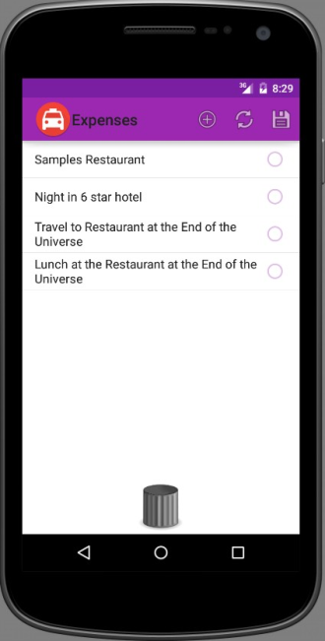
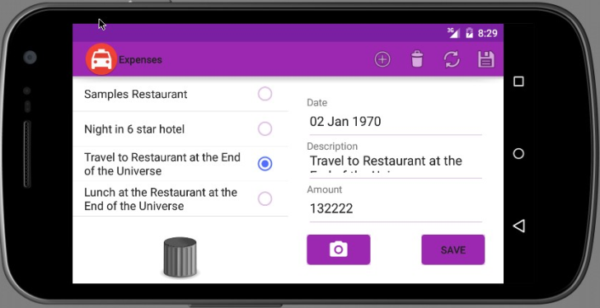
Fragments
Adaptive Layouts
Screen width resource qualifier may be useful
  Declare a layout showing one fragment if screen width less than 600dp
Can result in duplicated layout resource files
  Supporting resolution/width/orientation
  combinations
res/layout-w600dp/main.xml
Notes:
[Title of the course]
Nov 8, 2008
Copyright © 2004-2005 NameOfTheOrganization. All rights reserved.
55

Slide 56
Fragments
Avoiding Layout Duplication
Resource system allows layouts to be reused at multiple resolutions
Define layout shortcuts as resource files
Place shortcut folder in a values
folder with appropriate qualifiers
<resources>
<item name="main"
type="layout">@layout/narrow_layout</item>
</resources>
res
values
values-port
values-w600dp
Notes:
[Title of the course]
Nov 8, 2008
Copyright © 2004-2005 NameOfTheOrganization. All rights reserved.
56

Slide 57
Fragments
Adaptive Layouts
Our fragment-based layout works well for large screens/landscape mode
Need to handle portrait mode/small screens
Solution: Define multiple layouts using the resource system
For layouts where the Expenses fragment does not work (narrow/portrait)
Set the width of the ViewGroup holding the fragment to 0
Set the visibility to gone
Completely hidden, as if the view had not been added.
Notes:
[Title of the course]
Nov 8, 2008
Copyright © 2004-2005 NameOfTheOrganization. All rights reserved.
57

Slide 58
Fragments
Adapting to Small/Narrow Screens
Portrait layouts typically only have room for one fragment
  Container for second fragment must still be in the layout
  Otherwise, application may crash on rotation
Container should have zero width and a visibility of gone
<LinearLayout ...>
<FrameLayout android:id="@+id/frag_expense_list" …/>
<FrameLayout android:id="@+id/frag_expense_details"
android:layout_width="0px"
android:visibility="gone" …/>
</LinearLayout>
Notes:
[Title of the course]
Nov 8, 2008
Copyright © 2004-2005 NameOfTheOrganization. All rights reserved.
58

Slide 59
Fragments
Dynamic adaptation to Layout Change
If screen does not have room for two fragments
  Load the new fragment over the one that is visible
  And add the transaction to the back stack
    To simulate activity behavior
Fragment launching code needs to check for space
  Test containing ViewGroup visibility
Notes:
[Title of the course]
Nov 8, 2008
Copyright © 2004-2005 NameOfTheOrganization. All rights reserved.
59

Slide 60
Fragments
Dynamic adaptation to Layout Change
FragmentTransaction ft = …
ViewGroup containingView = findViewById(R.id.frag_expense_details);
if(containingView.getVisibility() != View.GONE){
ft.replace(R.id.frag_expense_details, frag);
} else {
ft.replace(R.id.frag_expense_list, frag);
ft.addToBackStack("details");
}
…
ft.commit();
Container is visible; replace the container
Container is not visible; replace the other fragment and add transaction to back stack
Notes:
[Title of the course]
Nov 8, 2008
Copyright © 2004-2005 NameOfTheOrganization. All rights reserved.
60

Slide 61
Questions ?

Slide 62
Dialogs
Android Development

Slide 63
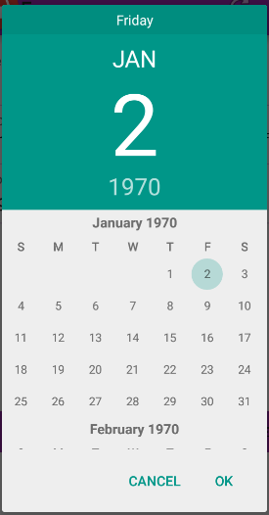
Dialogs
Interact with the user
Pop-up windows forcing the user to respond
Implemented by extending DialogFragment
Many different dialog types may be displayed
  AlertDialog, TimePickerDialog, DatePickerDialog…
Notes:
[Title of the course]
Nov 8, 2008
Copyright © 2004-2005 NameOfTheOrganization. All rights reserved.
63

Slide 64
Dialogs
Interact with the user
Android calls life-cycle method onCreateDialog()
  In response to a call to showDialog()
  Custom code returns an instance of the dialog to be displayed
Initialization values are passed to the dialog as an arguments Bundle
  Similar to the extra data used with Intents
Notes:
[Title of the course]
Nov 8, 2008
Copyright © 2004-2005 NameOfTheOrganization. All rights reserved.
64

Slide 65
Dialogs
DatePickerDialog Example
public void onClick(View v) {
  // Create the dialog fragment
  DatePickerFragment newFragment = new DatePickerFragment();
  // Prepare arguments to initialize the dialog
  // A Calendar in this example
  mExpenseDate = Calendar.getInstance();
  // Create a Bundle and add arguments to it
  Bundle args = new Bundle();
  args.putSerializable(DatePickerFragment.INPUT_DATE_MS, mExpenseDate);
  // Set the arguments on the fragment
  newFragment.setArguments(args);
  // Show the dialog
  newFragment.show(getActivity().getSupportFragmentManager(),
  "datePicker");
}
Notes:
[Title of the course]
Nov 8, 2008
Copyright © 2004-2005 NameOfTheOrganization. All rights reserved.
65

Slide 66
Dialogs
DatePickerDialog Example
public class DatePickerFragment extends DialogFragment
implements DatePickerDialog.OnDateSetListener {
public static final String INPUT_DATE_MS =
"Input Date in Millis”;
@Override
public Dialog onCreateDialog(Bundle savedInstanceState) {
// Use the current date as the default date in the picker
final Calendar c = (Calendar)
getArguments().getSerializable(INPUT_DATE_MS);
// Return a new instance of DatePickerDialog
return new DatePickerDialog(getActivity(), this,
c.get(Calendar.YEAR),
c.get(Calendar.MONTH),
c.get(Calendar.DAY_OF_MONTH));
}
…
}
Notes:
[Title of the course]
Nov 8, 2008
Copyright © 2004-2005 NameOfTheOrganization. All rights reserved.
66

Slide 67
Dialogs
DatePickerDialog Example
DatePickerDialog notifies handler (dialog fragment) of date selection
  Calls onDateSet() method defined by DatePickerDialog.OnDateSetListener
public class DatePickerFragment extends DialogFragment
implements DatePickerDialog.OnDateSetListener {
…
public void onDateSet(DatePicker view, int y, int m, int d) {
// Do something with the date chosen by the user
final Calendar c = Calendar.getInstance();
c.set(Calendar.YEAR, y);
c.set(Calendar.MONTH, m);
c.set(Calendar.DAY_OF_MONTH, d);
updateDate(c);
}
Notes:
[Title of the course]
Nov 8, 2008
Copyright © 2004-2005 NameOfTheOrganization. All rights reserved.
67

Slide 68
Questions ?

Slide 69
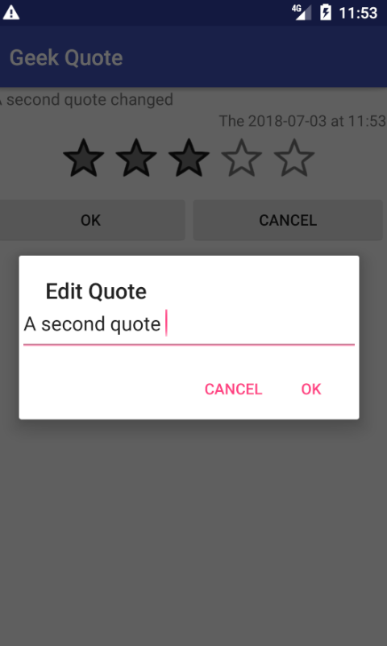
Dialogs
Exercise
Add a long click event to the TextView containing quote text
  Display a Dialog box allowing user to edit it
  Use Android documentation about Dialog class if you need :
    http://developer.android.com/guide/topics/ui/dialogs.html#AlertDialog
Notes:
[Title of the course]
Nov 8, 2008
Copyright © 2004-2005 NameOfTheOrganization. All rights reserved.
69

Slide 70
TOASTS
Android Development

Slide 71
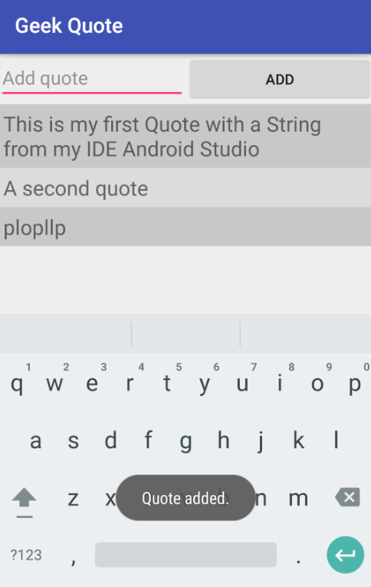
Notifications
Toasts
To display on the screen, define:
  An Activity
  A short text
  Time to display (SHORT or LONG)
// Create a Toast
Toast.makeText(this, "Quote added.", Toast.LENGTH_SHORT).show();
Notes:
[Title of the course]
Nov 8, 2008
Copyright © 2004-2005 NameOfTheOrganization. All rights reserved.
71

Slide 72
Questions ?

Slide 73

The end
Thanks for your attention

